Slide 1
Object Oriented Programming Lecture - 5
Prof. Dnyaneshwar Kanade

Slide 2
Java Methods, Constructors
A constructor is a special kind of method that is used to initialize newly created objects.
Java has a special way to declare the constructor and a special way to invoke the constructor.

Slide 3
Java Methods, Constructors
Constructor does not return any value where the method may/may not return a value.
In case constructor is not present, a default constructor is provided by java compiler. In the case of a method, no default method is provided.
Constructor should be of the same name as that of class.
Method name should not be of the same name as that of class.

Slide 4
Java Methods, Constructors
Following are the difference between constructor and method.
Constructor is used to initialize an object whereas method is used to exhibits functionality of an object.
Constructors are invoked implicitly whereas methods are invoked explicitly.

Slide 5
Constructor
A constructor initializes an object when it is created. It has the same name as its class and is syntactically similar to a method. However, constructors have no explicit return type.
Typically, you will use a constructor to give initial values to the instance variables defined by the class, or to perform any other start-up procedures required to create a fully formed object.

Slide 6
Constructor
All classes have constructors, whether you define one or not, because Java automatically provides a default constructor that initializes all member variables to zero.
However, once you define your own constructor, the default constructor is no longer used.

Slide 7
Constructor
Class classname {
classname(){
}
}
Java allows two types of constructors namely −
No argument Constructors
Parameterized Constructors

Slide 8
No argument Constructors
As the name specifies the no argument constructors of Java does not accept any parameters.
Using these constructors the instance variables of a method will be initialized with fixed values for all objects.

Slide 9
No argument Constructor-Example
class constr
{
public static void main (String[] args)
{
// this would invoke default constructor.
MyClass MC = new MyClass();
// Default constructor provides the default
// values to the object like 0, null
System.out.println(MC.name);
System.out.println(MC.num);
}
}
// Java Program to illustrate calling a
// no-argument constructor
import java.io.*;
class MyClass
{
int num;
String name;
// this would be invoked while an object
// of that class is created.
MyClass()
{
System.out.println("Constructor called");
}
}

Slide 10
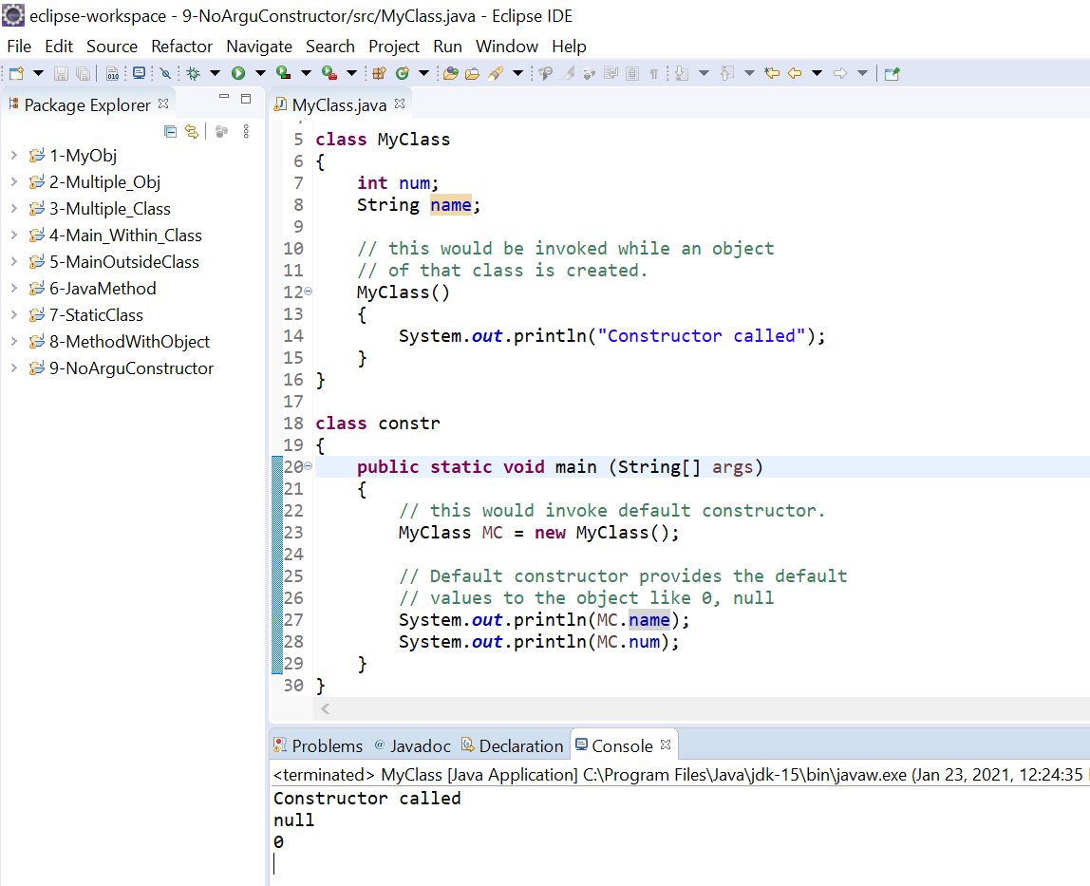
Output

Slide 11
Parameterized Constructors
Most often, you will need a constructor that accepts one or more parameters.
Parameters are added to a constructor in the same way that they are added to a method, just declare them inside the parentheses after the constructor's name.
A constructor that has parameters is known as parameterized constructor.
If we want to initialize fields of the class with our own values, then we use a parameterized constructor.

Slide 12
Parameterized Constructors -Example
// Java Program to illustrate calling of
// parameterized constructor.
import java.io.*;
class Para
{
// data members of the class.
String name;
int id;
// constructor would initialize data members
// with the values of passed arguments while
// object of that class created.
Para(String name, int id)
{
this.name = name;
this.id = id;
}
}
class GFG
{
public static void main (String[] args)
{
// this would invoke the parameterized constructor.
Para p1 = new Para("VIT", 1);
System.out.println("CollegeName :" + p1.name +
" and CollegeId :" + p1.id);
}
}

Slide 13
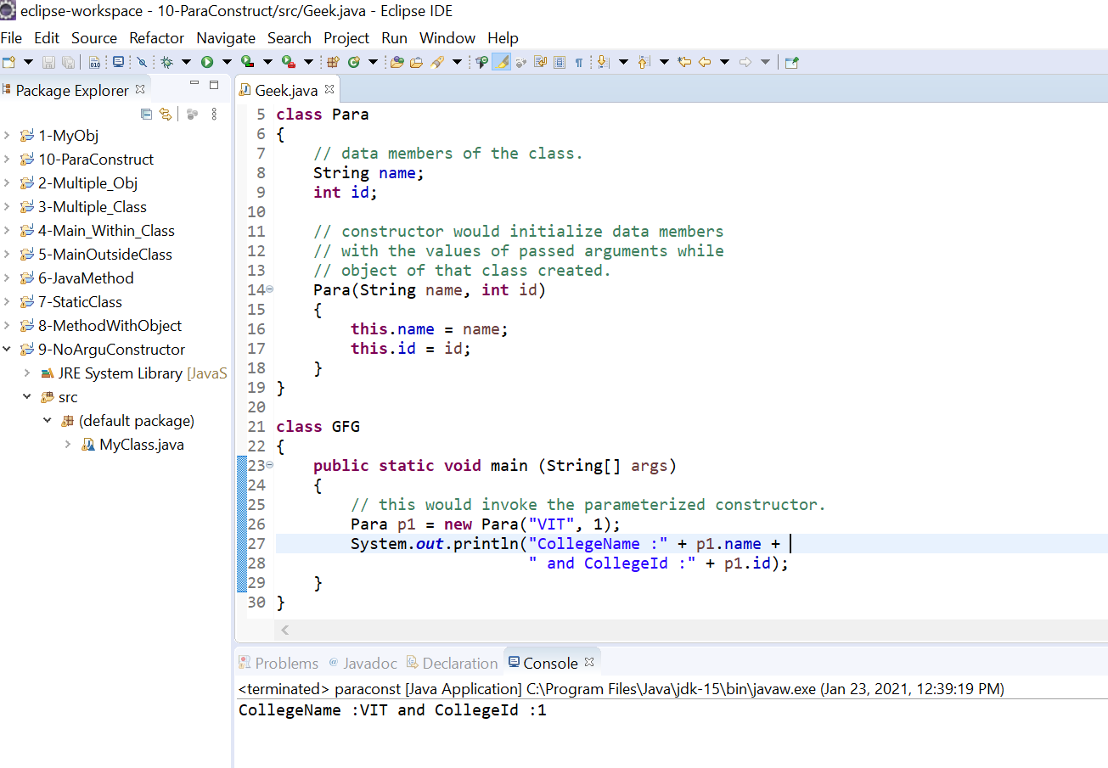
Output

